Slide 1
Reconstruction of windmills to generate
electricity and pump water for the communities in Namibia
By Mr. Pedro E Tjakwanda
TEACHERS INFORMATION SEMINAR
03 October 2022

Slide 2
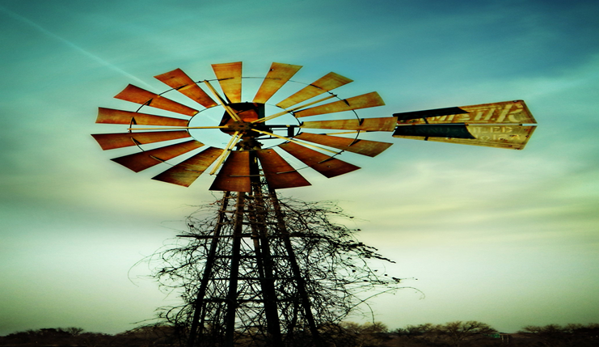
General Background
Farmers in Namibia uses windmill to pull water from the ground.
Figure 1. shows a current windmill used in Namibia.
Namibia is at its pick in terms of increase in water bills.
Figure 1:

Slide 3
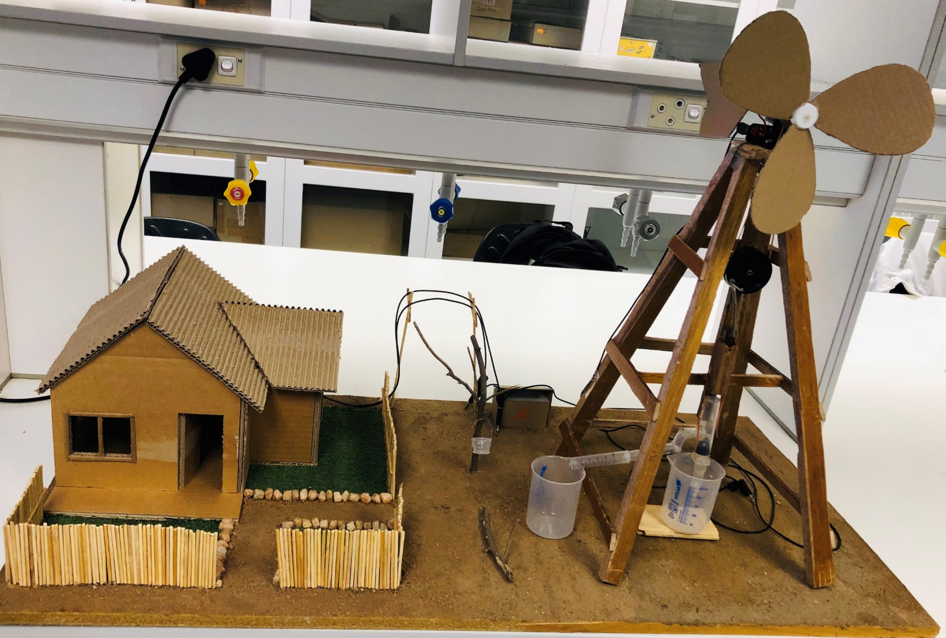
New Proposed design
Figure :2

Slide 4
Methodologies
Windmill
Water is than transferred to the tanks of which it will undergo purified using Prof. Kwaambwa purification system
General electricity (motor) while pulling water from the ground
Electricity produced will than be stepped up and/or down using a transformer
Purified water is than used for human consumption and agricultural activities
Supply to the community
Notes:
Study Design
This is a
Observational, descriptive cross-sectional study.
Sampling Method
Purposive sampling will be employed to collect samples.
The sampling points were chosen to represent areas where various human activities occur.
This will give information on the amount of radiation the human population is likely to be exposed to.

Slide 5
Expected problems
Overflow of water
Too much store energy
Low energy production
Solution
A build in automatic control switch
Usage of rechargeable battery

Slide 6
Research to be done;
Geology of the targeted communities
Locations of targeted communities
Environmental Impact assessment

Slide 7

Why the initiative?
Invention
Determination
Academic progress
Contribution

Slide 8
Thank you

